Slide 1

SCRAMBLER
SOCIAL INNOVATION IN PRACTICE
TEAM - 8
K.KARTHIK -22H51A7393
K.ABHISHEK -22H51A7395
Y.POOJITHA -22H51A73A2
MD.SOHAIL AZMATH -22H51A73A4
MUSKAN ANJUM -22H51A73A8
FACULTY DETAILS:
Mr. P. Maheshbabu , Asst. Professor CEER/MECH
2.Mr.K.Ravi Kiran, Asst . Professor CEER/ECE
3.Mr.K.Raju,Asst.Professor CEER/ECE

Slide 2
PROBLEM STATEMENT
There is a need of a machine that can go through hurdles like uneven terrain, highways, bridges, hilly areas and many more and also drop the items at the given particular place so that it can serve the people who met an accident or any other need at a place where it’s not easy to reach. We need a manually controlled robot to do this.

Slide 3
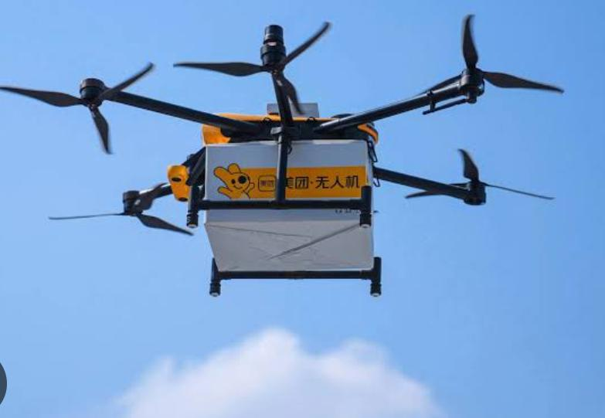
EXISTING SOLUTION
Hill climber vehicles :-Hill climber vehicles, often referred to as off-road or all-terrain vehicles, are specialized vehicles designed for traversing steep, rugged, and challenging terrains, including hills, mountains, deserts, forests, and other rough landscapes. These vehicles are engineered to handle a wide range of adverse conditions and offer superior off-road capabilities compared to regular automobiles. They are commonly used for recreational purposes, such as off-roading and extreme sports, as well as for various industrial and military applications.
Aerial appliances :- Helicopters, drones, and other aerial appliances are commonly used to deliver essential items to hilly and remote areas where traditional ground transportation may be challenging or impossible due to rugged terrain, lack of infrastructure, or adverse weather conditions. These methods are particularly crucial for emergency response, medical supply delivery, and providing aid in isolated regions.

Slide 4
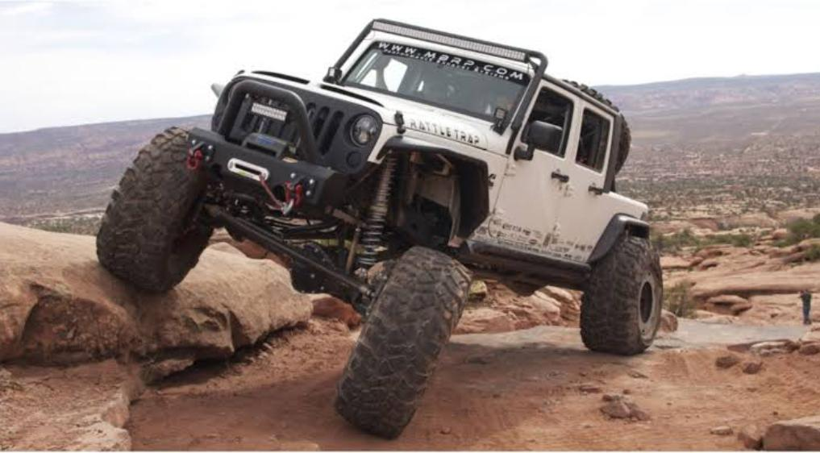
GAPS ON EXISTING SOLUTION
Hill climber vehicles :-
These vehicles are manually controlled and they don’t have any gripping machines and also they don’t even have space for items to carry.
These are driven by humans which is dangerous.
Also we need a skilled humans to drive this.
Aerial appliances :-
These are very costly.
They need frequent maintenance.

Slide 5
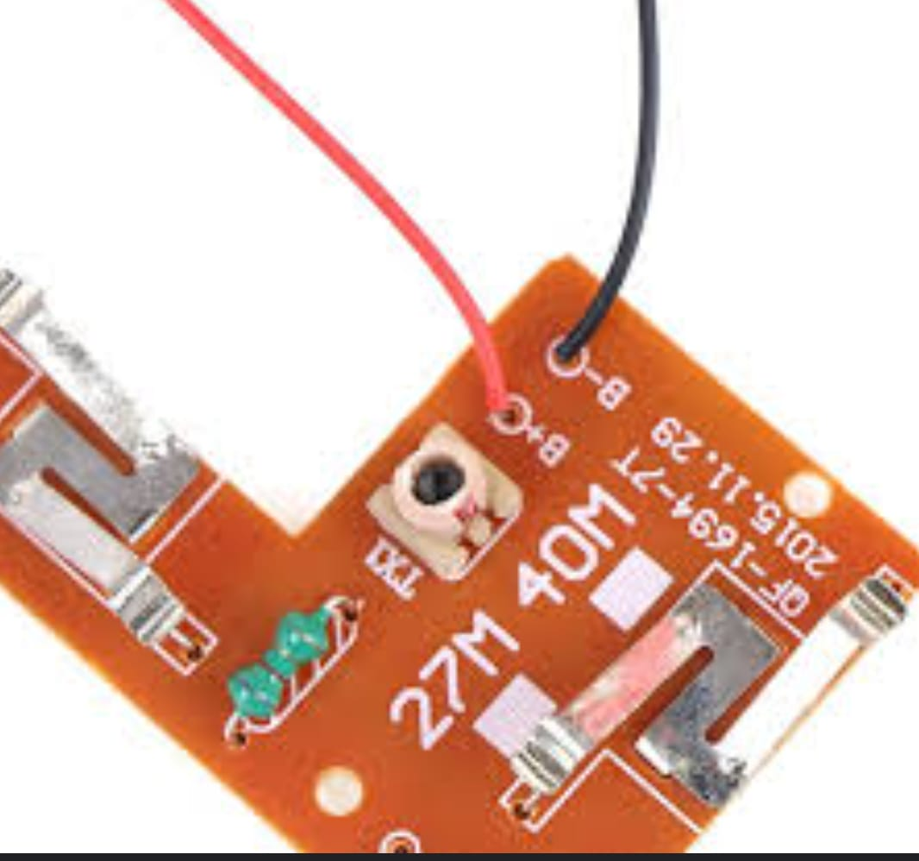
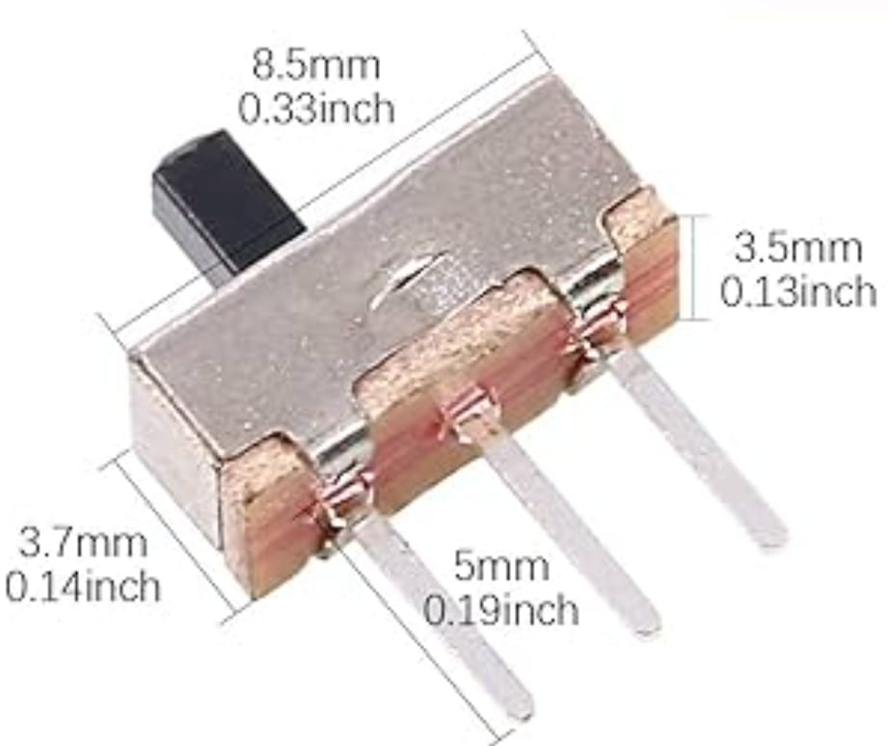
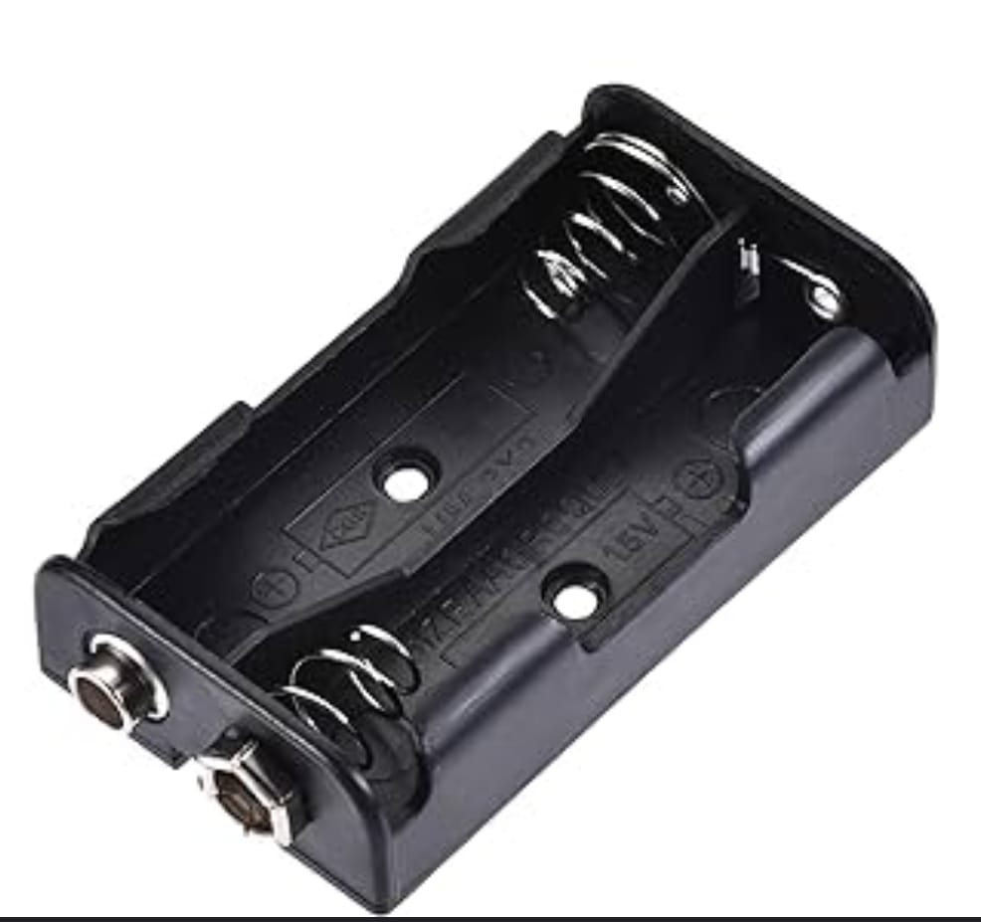
Components required
RC 40mHz Tx and Rx boards
Drive motor 180-type
Pulley wheels, Rubber belt/band, and car wheels from Gear Kit
(x3) Dual AA battery holder trays
(x6) AA Alkaline Batteries
ON/OFF Rocker switch 3A
(x4) Momentary pushbutton switches
Micro slide switch SPDT
330 Ohm resistor + LED from Kit
(x2) Micro screws for drive motor

Slide 6
PROPOSED SOLUTION
We need to build a manually controlled bot that can do simple tasks of gripping objects and putting them in target zones so that it can complete the route by overcoming the hurdles in its path.

Slide 7
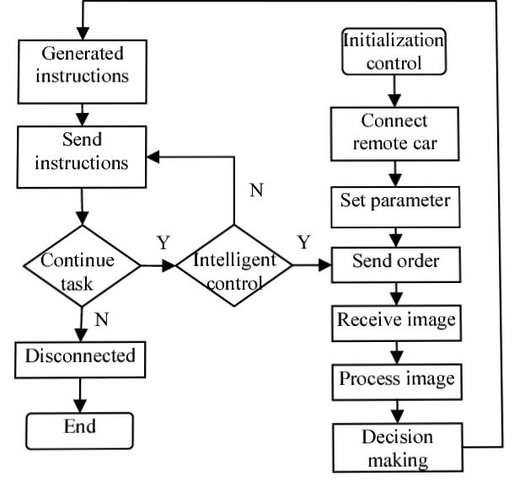
FLOW CHART
START

Slide 8
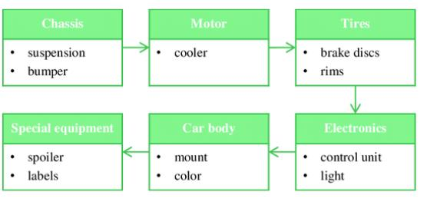
Block diagram

Slide 9
PLAN OF ACTION
Define Bot Specifications
Research and Design
Chassis and Wheels Selection
Gripper Mechanism Design
Control Mechanism Selection
Microcontroller Selection
Motor Drivers Selection
Power Supply Setup
Frame and Mounting Hardware
Assembly & Testing
Final Adjustments

Slide 10

There are an endless number of things to discover about robotics. A lot of it is just too fantastic for people to believe.

